Slide 1

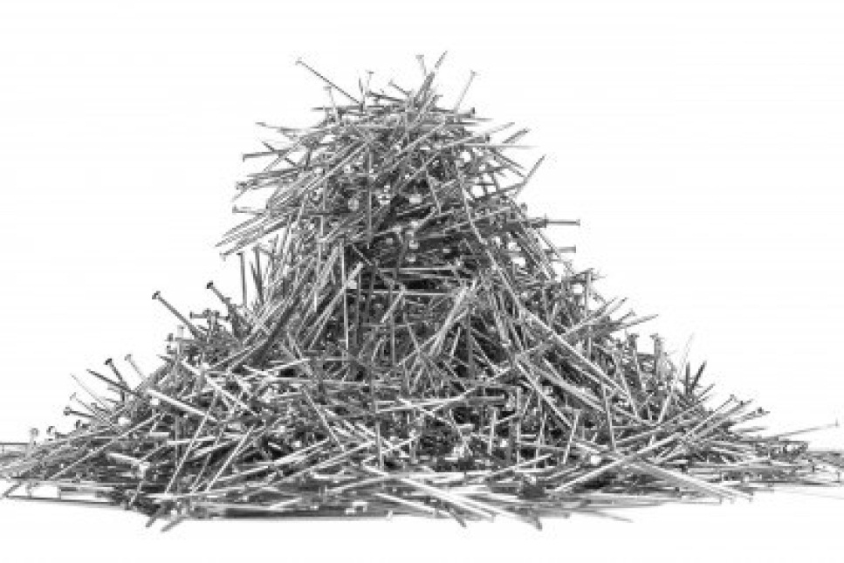
What is a heap?
Always keep the thing we are most interested in close to the top (and fast to access).
Like a binary search tree, but less structured.
No relationship between keys at the same level (unlike BST).

Slide 2
Types of heaps
Min heap: priority 1 more important than 100
Max heap: 100 more important than 1
We are going to talk about max heaps.
Max heap-order property
Look at any node u, and its parent p.
p.priority ≥ u.priority
p:7
u:3

Slide 3
Abstract data type (ADT)
We are going to use max-heaps to implement the (max) priority queue ADT
A priority queue Q offers (at least) 2 operations:
Extract-max(Q): returns the highest priority element
Insert(Q, e): inserts e into Q
Every time an Insert or Extract-max changes the heap, it must restore the max-heap order property. (← Prove by induction on the sequence of inserts and extract-maxes that occur.)
Notes:
Heaps are faster! =D

Slide 4
What can we do with a heap
Can do same stuff with a BST… why use a heap?
BST extract-max is O(depth); heap is O(log n)!
When would we use a BST?
When we need to search for a particular key.

Slide 5
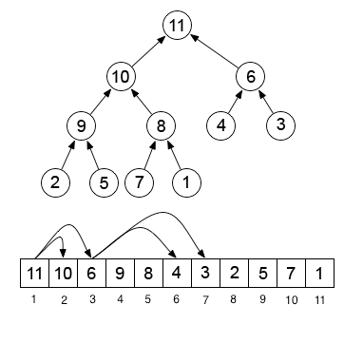
Storing a heap in memory
Heaps are typically implemented with arrays.
The array is just a level-order traversal of the heap.
The children of the node at index i are at 2i and 2i+1.

Slide 6
Example time
Interactive heap visualization
Insert places a key in a new node that is the last node in a level-order-traversal of the heap.
The inserted key is then “bubbled” upwards until the heap property is satisfied.
Extract-max removes the last node in a level-order-traversal and moves its key into the root.
The new key at the root is then bubbled down until the heap property is satisfied.
Bubbling down is also called heapifying.

Slide 7
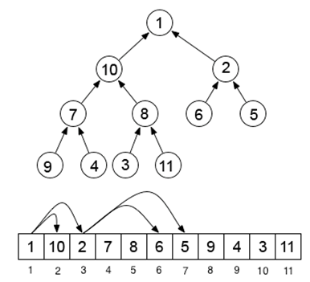
Building a max-heap in O(n) time
Suppose we want to build a heap from an unsorted array: 10, 2, 7, 8, 6, 5, 9, 4, 3, 11.
We start by interpreting the array as a tree.

Slide 8
Building a heap: a helper function
I:3
Precondition: trees rooted at L and R are heaps
Postcondition: tree rooted at I is a heap
MaxHeapify(A,I):
L = LEFT(I)
R = RIGHT(I)
If L ≤ heap_size(A) and A[L] > A[I]
then max = L
else max = I
If R ≤ heap_size(A) and A[R] > A[max]
then max = R
If max is L or R then
swap(A[I],A[max])
MaxHeapify(A,max)
Case 1: max = L
Need to fix…
L:7
R:5
I:7
Case 2: max = I
Heap OK!
L:3
R:5
I:5
Case 3: max = R
Need to fix…
L:3
R:7
Notes:
Sketch the code, then walk them through the cases, then discuss the precondition and postcondition, then show them how, e.g., case three works (meaning the postcondition is satisfied if the precondition is satisfied).

Slide 9
Proving MaxHeapify is correct
How would you formally prove that MaxHeapify is correct?
Goal: Prove MaxHeapify is correct for all inputs. “Correct” means: “if the precondition is satisfied when MaxHeapify is called, then the postcondition will be satisfied when it finishes.”
How do we prove a recursive function correct?
Define a problem size, and prove correctness by induction on problem size.
Base case: show function is correct for any input of the smallest problem size.
Inductive step: assume function is correct for problem size j; show it is correct for problem size j+1.

Slide 10
Proving MaxHeapify is correct - 2
Let’s apply this to MaxHeapify.
Problem size: height of node I.
Base case: Prove MaxHeapify is correct for every input with height(I) = 0.
Inductive step: Let A and I be any input parameters that satisfy the precondition. Assume MaxHeapify is correct when the problem size is j. Prove MaxHeapify is correct when the problem size is j+1.

Slide 11
Proving MaxHeapify is correct - 3
I:3
Precondition: trees rooted at L and R are heaps
Postcondition: tree rooted at I is a heap
MaxHeapify(A,I):
L = LEFT(I)
R = RIGHT(I)
If L ≤ heap_size(A) and A[L] > A[I]
then max = L
else max = I
If R ≤ heap_size(A) and A[R] > A[max]
then max = R
If max is L or R then
swap(A[I],A[max])
MaxHeapify(A,max)
Case 1: max = L
Need to fix…
L:7
R:5
I:7
Case 2: max = I
Heap OK!
L:3
R:5
I:5
Case 3: max = R
Need to fix…
L:3
R:7
Notes:
Base case: j = 0. Any node with height 0 is a heap, so the post condition is satisfied.
Inductive step: Assume MaxHeapify is correct when its input I has height j. Show it is correct when I has height j+1.
Explain case 3 as an example.

Slide 12
The main function
BUILD-MAX-HEAP(A):
for i = heap_size(A)/2 down to 1
MaxHeapify(A,i)
Notes:
Why do we iterate from heap_size(A)/2 and not from heap_size(A)?
Why do we iterate backwards? (What do we know about the nodes from heap_size(A)/2 down to 1? Is there any point in calling max heapify on any of the other nodes?) We need to know that max heapify’s precondition is satisfied, in order for us to call it… Show how, this way, the precondition is satisfied, so the postcondition guarantees that we are always building larger and larger heaps, as we move up.

Slide 13
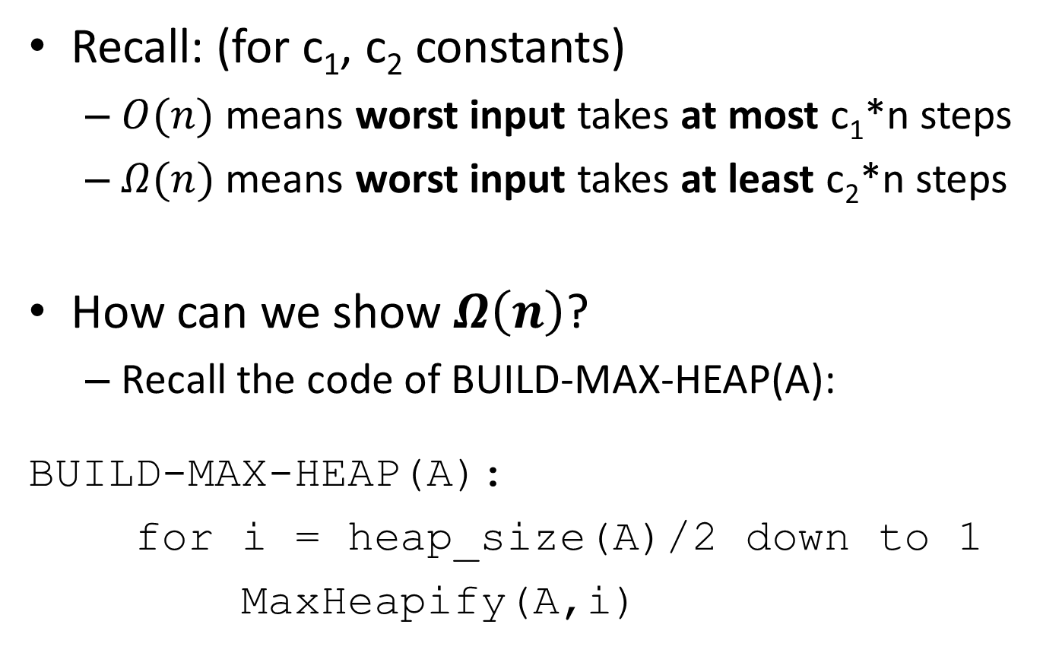
Analyzing worst-case complexity

Slide 14
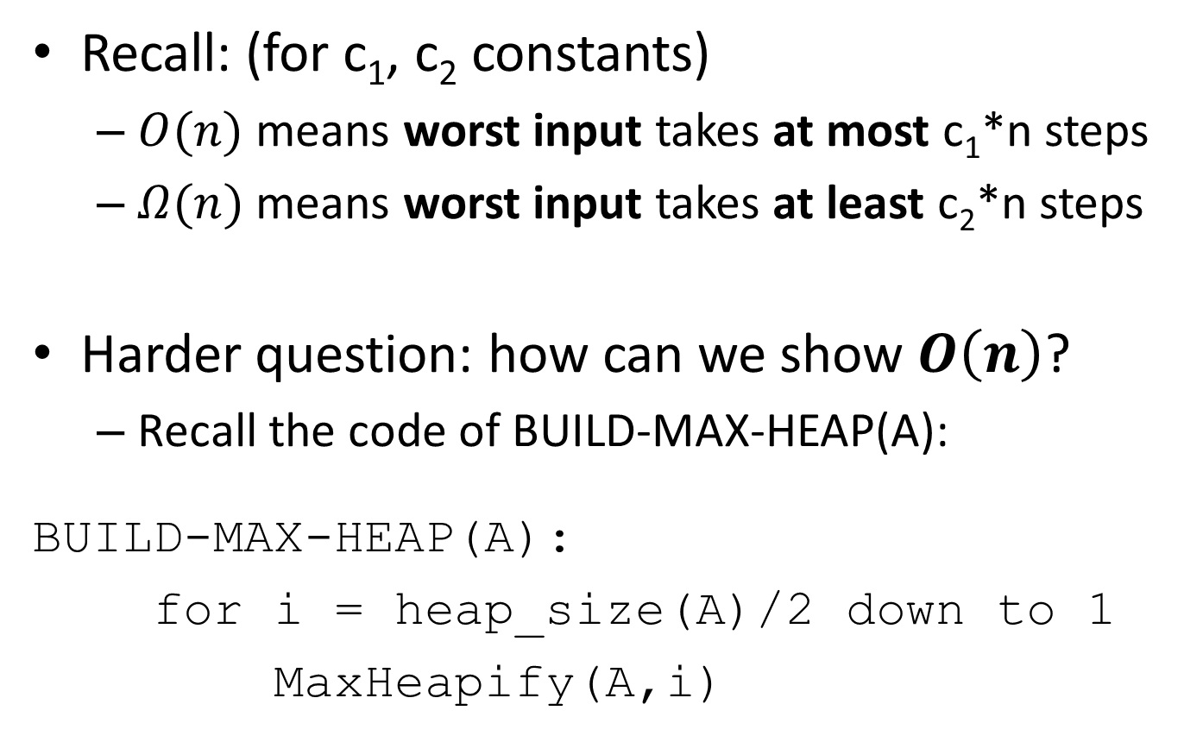
Analyzing worst-case complexity

Slide 15

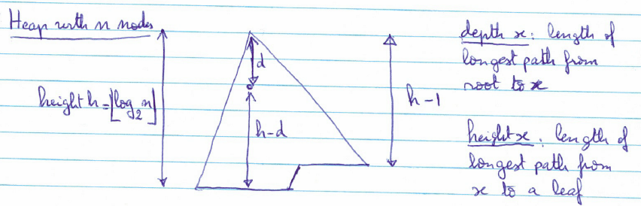
≤ 2^{d} nodes at depth d
Node at depth d has height ≤ h-d
Cost to “heapify” one node at depth d is ≤ c(h-d)
Don’t care about constants... Ignoring them below…
Cost to heapify all nodes at depth d is ≤ 2^{d} (h-d)

Slide 16
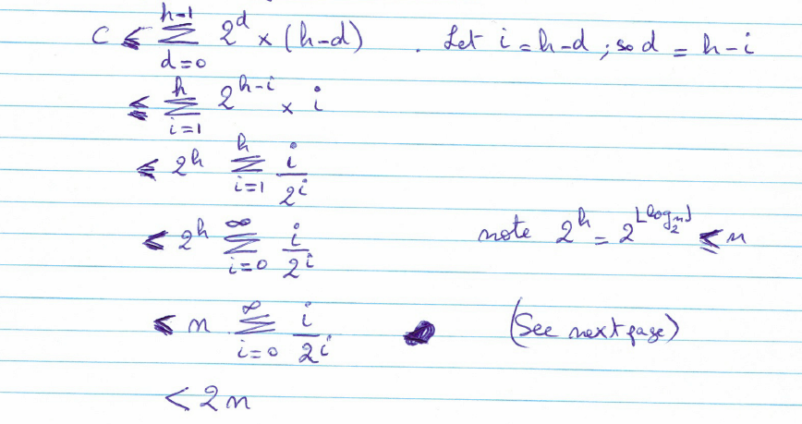
So, cost to heapify all nodes over all depths is:

Slide 17
